Slide 1
PORTAS E AFINS DE REDE

Slide 2
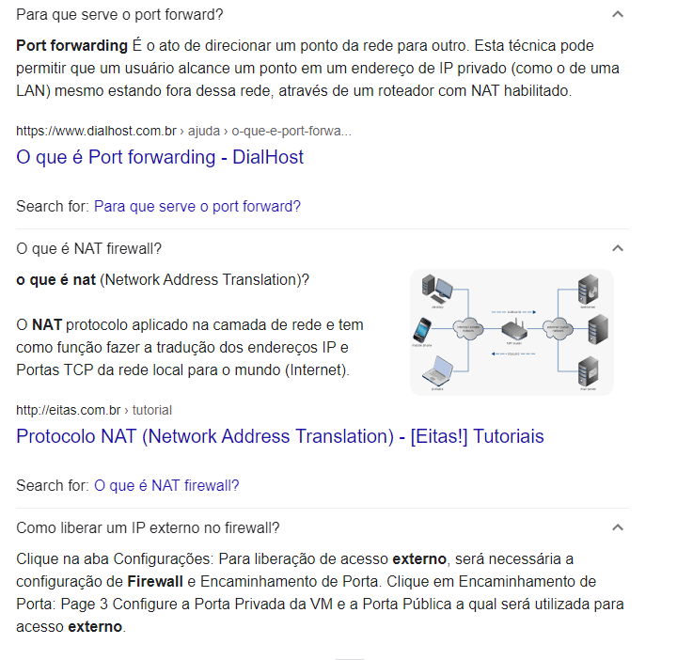

Slide 3
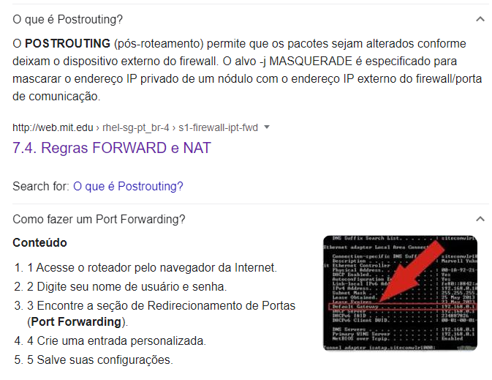

Slide 4
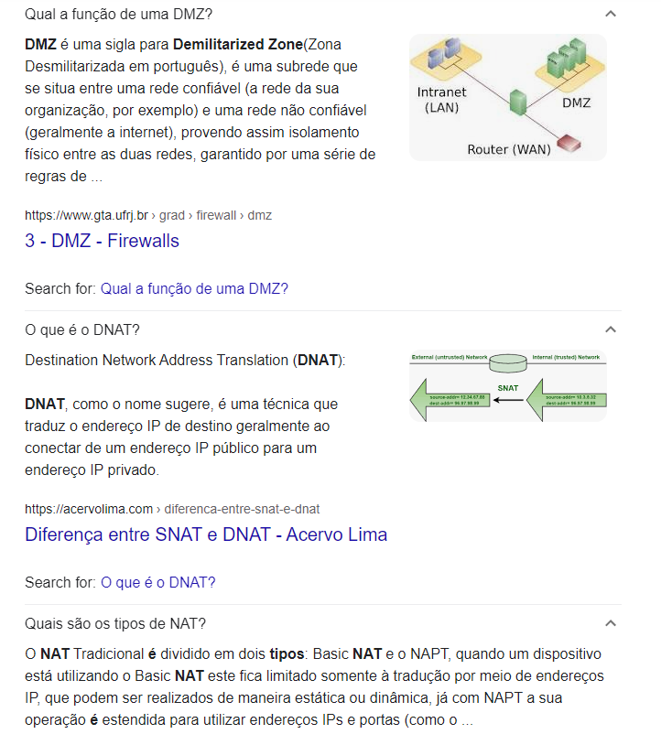

Slide 5
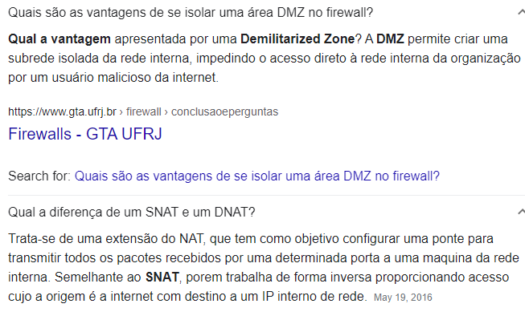


Slide 6

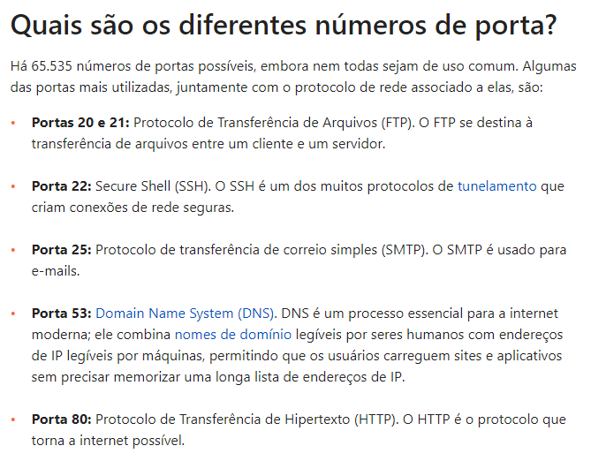
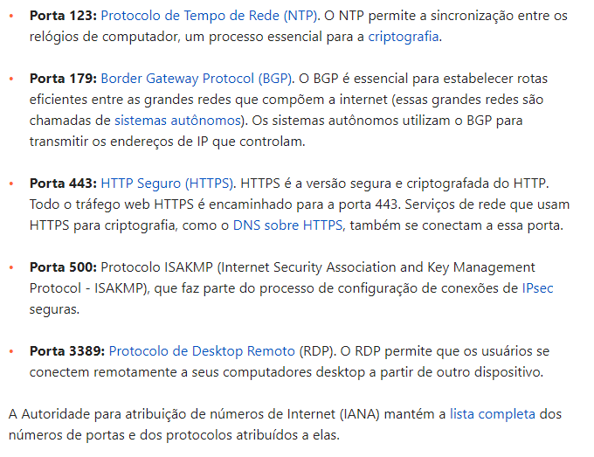
https://www.iana.org/assignments/service-names-port-numbers/service-names-port-numbers.xhtml

